Slide 1
UNIT 15 – Object oriented programming
With ben read

Slide 2
Aims & objectives
Analyse further uses for Pointers in C/C++
Discuss arrays of pointers, pointer to pointer, and pointer use in functions
Review the week’s techniques via a self-paced tutorial

Slide 3
Pointer to an array
Many of you will have utilised a pointer to an array in your procedural practical assignment. Instead of declaring a two dimensional array to store a string of a defined length, you can declare a pointer to an array like so –
char *string[]
A string in C is just a char array. Using a pointer allows you to enter strings without being restricted by predefined array length. The pointer to the array will dynamically allocate memory for each char as it is entered. This is very useful if you’re unsure of the length of the string that will be input. You can recall the entire string simply by referencing the element that contains the first character. The second dimension is not required as it has been dynamically allocated, e.g.
cout << “Value of “ << string[1]

Slide 4

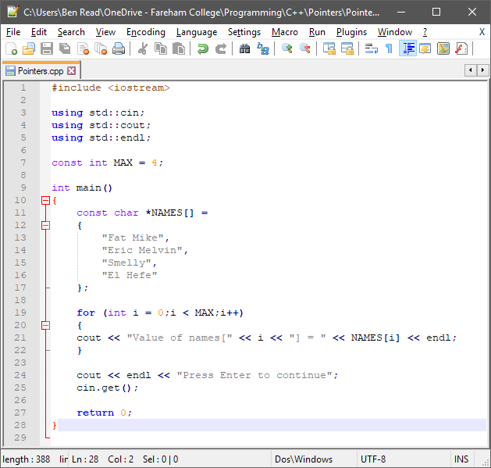
Pointer to array
One important thing to note – if you want to declare your string before compilation then you will need to create a constant array in order to allocate the memory
When this code is compiled and executed, it produces −
Value of names[0] = Fat Mike
Value of names[1] = Eric Melvin
Value of names[2] = Smelly
Value of names[3] = El Hefe

Slide 5
Pointer to a pointer
We’ve already seen these in action, as an array is also a pointer. However, you can also declare pointers to normal pointers. To do this requires two dereference operators –
int var;
int *ptr;
int **pptr;
var = 10;
ptr = &var //ptr is equal to the memory address of var
pptr = &ptr //pptr is equal to the memory address of ptr

Slide 6
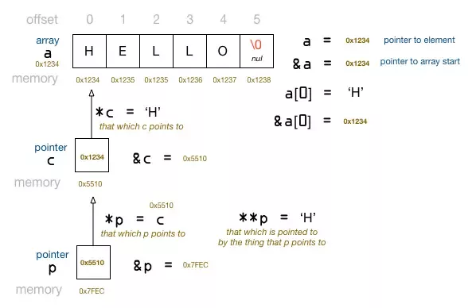
Pointer to a pointer
A pointer to a pointer can return the memory address of the pointer it is pointing to, or the value or the memory address of the variable the pointer it is pointing to is pointing at. To do this you add however many dereference operators are required to reach the intended value. This is better represented as a diagram.

Slide 7
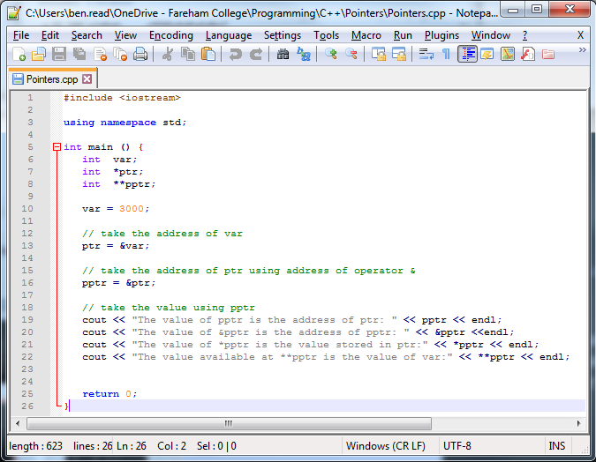
Pointer to a pointer
When this code is compiled and executed, it produces −
0x61ff18 (Address of ptr)
0x61ff22 (Address of pptr)
0x61ff14 (Address of var)
10 (Value of var)

Slide 8
Call by reference
And so we’ve come full circle. We’ve already covered functions and calling by value or reference. Now that we’ve taken a closer look at pointers it becomes more apparent exactly what is going on when calling by reference. Using pointers in a function declaration, and sending the memory address of variables to the function, allows that function to directly write to values which exist outside of the function.
No return value is required and you can alter as many variables with the same function as you like. You may remember the following code from last term, slightly edited for C++

Slide 9

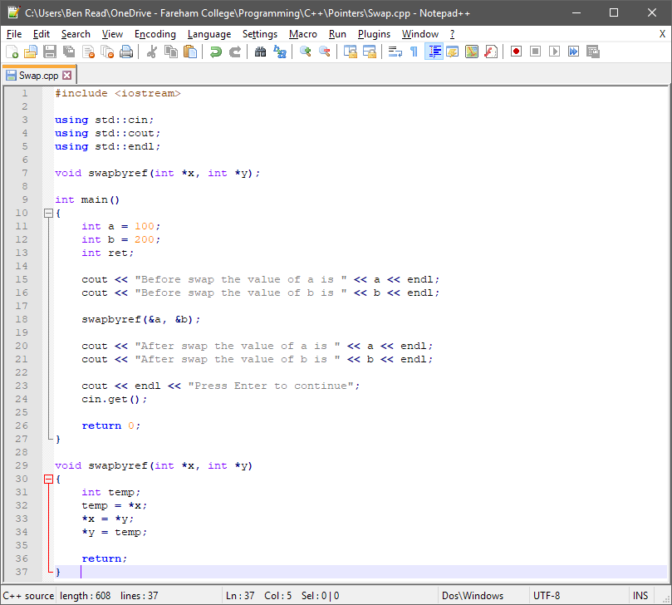
Call by reference
When this code is compiled and executed, it produces −
Before swap the value of a is 100
Before swap the value of b is 200
After swap the value of a is 200
After swap the value of b is 100

Slide 10


